Slide 1
Cryogenics for
Superconducting Magnets
Tom Peterson, SLAC
USPAS
January, 2017

Slide 2
Outline
Introduction – magnet thermal design issues
An example of thermal considerations for forced-flow, normal helium I cooling – Tevatron magnet cooling
An example of thermal considerations for stagnant, pressurized, helium II cooling – LHC final focus quadrupole
Thermal siphon cooling

Slide 3
Cooling modes in large-scale cryogenic systems recently in operation
Pool boiling helium I (SRF for HERA, LEP, KEKB, CESR)
Forced flow of subcooled or supercritical helium I (Tevatron, HERA, SSC)
Stagnant, pressurized helium II (the Tore Supra tokamak in France demonstrated the technology, LHC)
Saturated helium II (CEBAF, TTF at DESY, SNS at Oak Ridge, and foreseen for ILC)
This list also illustrates the extent to which superconductivity and cryogenics have become standard technology for accelerators

Slide 4
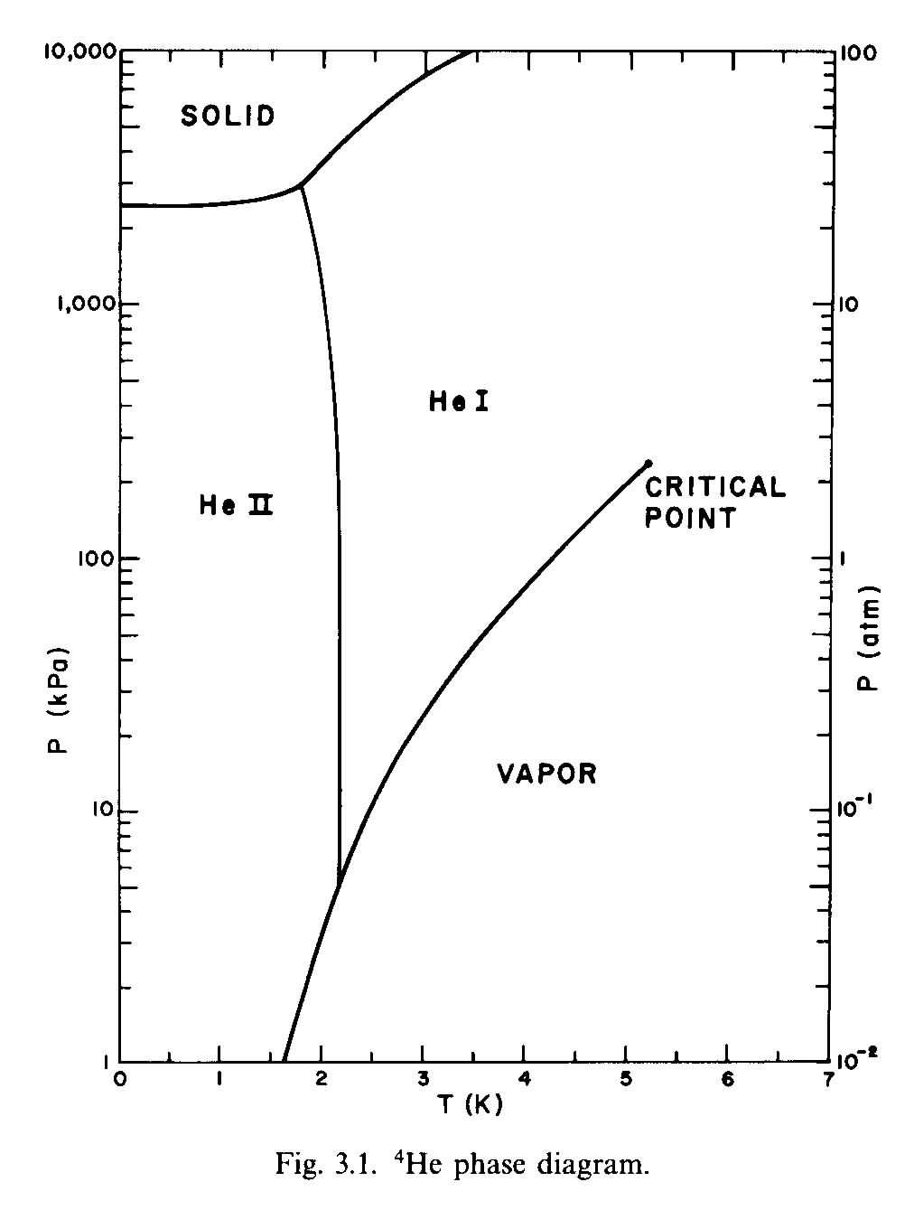
Helium phase diagram
(S. W. VanSciver, Helium Cryogenics, p. 54)
Critical point
  5.2 K, 2.245 atm
Lambda transition at 1 atm
  2.172 K
SRF -- HERA, LEP, KEKB, CESR
Magnets -- HERA, Tevatron
Magnets -- SSC
Magnets -- Tore Supra, LHC
SRF -- CEBAF, TTF, SNS, ILC

Slide 5
Cooling modes -- magnets vs RF
Accelerator magnets are often cooled with subcooled liquid
  Typically working near the limit of the superconductor with large stored energy
  Ensure complete liquid coverage and penetration
Superconducting RF cavities are generally cooled with a saturated bath
  Large surface heat transfer in pool boiling for local “hot spots”
  Very stable pressures, avoid impact of pressure variation on cavity tune

Slide 6
Pressurized versus pool boiling
Pressurized helium (normal or superfluid) gives maximum penetration of helium mass in magnet coils, which may be a factor in stability if not also heat transfer. But heat flow results in a temperature rise.
Pool boiling gives pressure stability (important for superconducting RF), provides maximum local heat transfer, and provides nearly isothermal cooling.

Slide 7
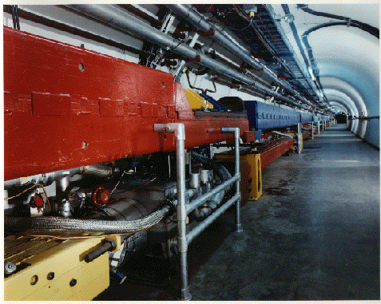
Tevatron

Slide 8
Fermilab’s magnet cooling scheme
Rapid cycling machine originally designed for fixed target physics implied warm iron magnets
Warm iron constrained cryostat and helium channels to small diameter
  Which resulted in somewhat larger static heat
  plus high pressure drop
Two phase helium flow to remove static heat
  Coil bathed in pressurized liquid which is cooled by 2-phase
Keeping pressure (hence temperature) low required short string lengths

Slide 9
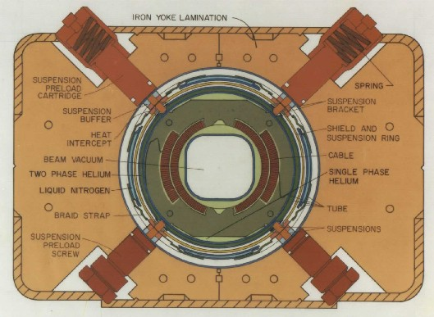
Tevatron dipole cross-section

Slide 10
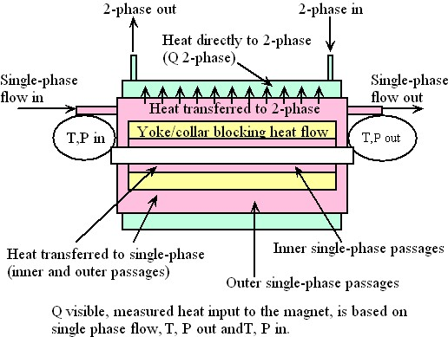
Fermilab magnet cooling scheme

Slide 11
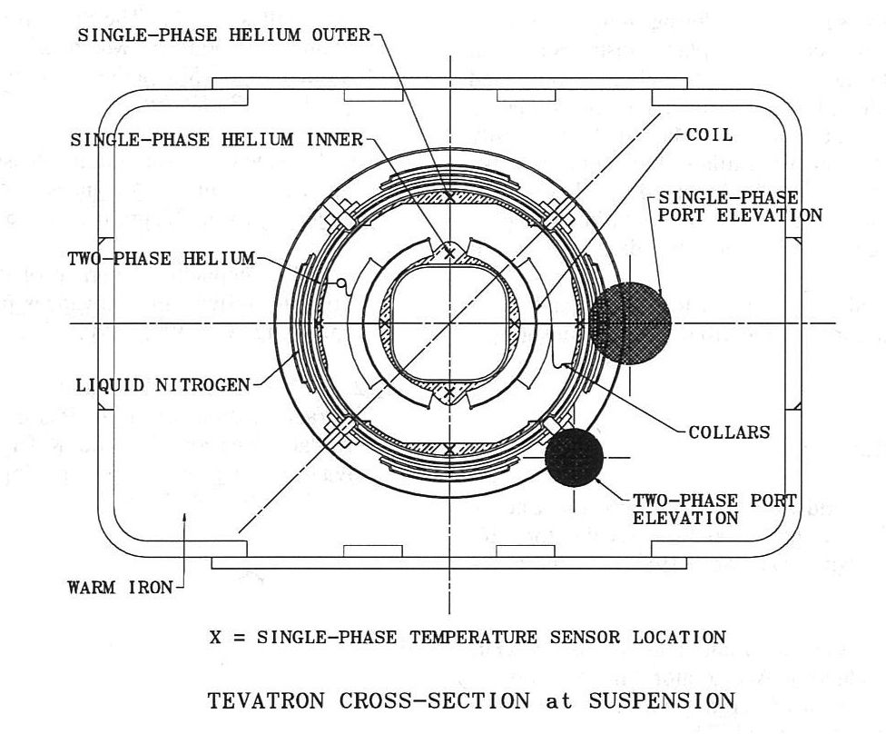

Slide 12
Tevatron dipole cooling issue
We knew that Tevatron dipole magnet helium was probably temperature-stratified
This could be a limitation for quench current
  We wanted 1 TeV, had to run at lower energies, finally 980 GeV as limited by the magnets
In TeV dipole TC0603 at the magnet test facility, we did some rather extensive thermal studies
Published results – “The Nature of the Helium Flow in Fermilab’s Tevatron Dipole Magnets”, by Thomas J. Peterson, Cryogenics, July 1997
Here are the highlights

Slide 13
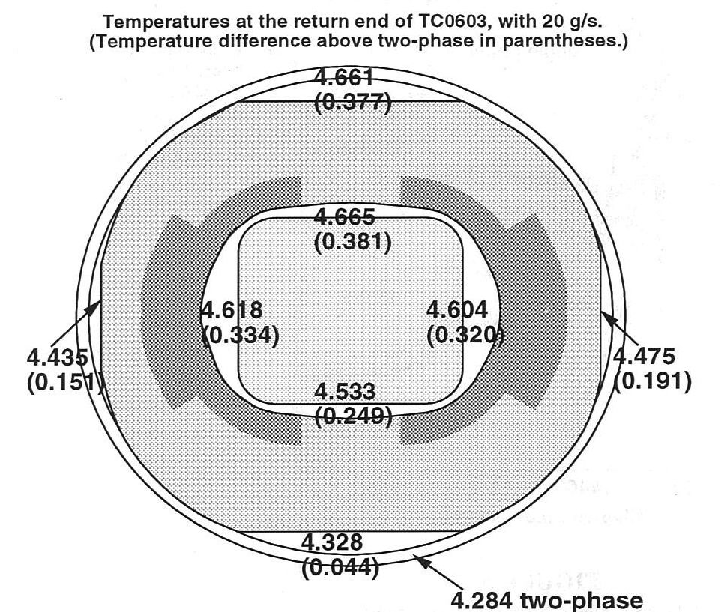
Measured temperatures

Slide 14
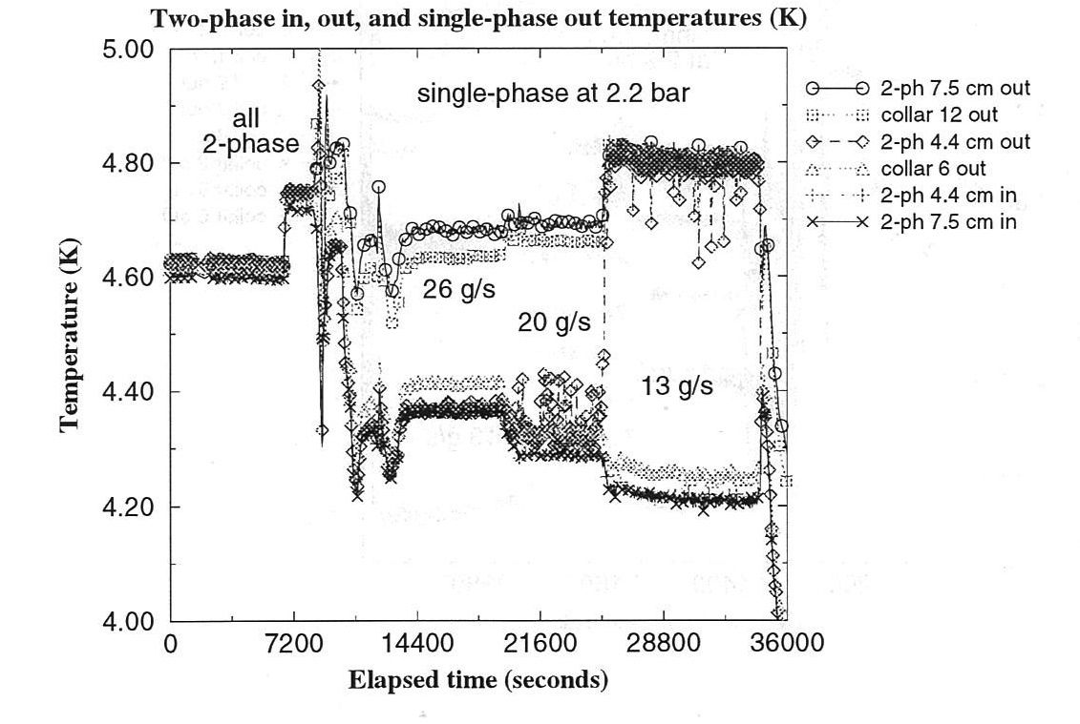
Measured temperatures plotted

Slide 15
Conclusion – dramatic stratification
Tevatron dipole cooling flow was indeed quite stratified
The low liquid level on the 2-phase side contributed to this stratification
Not much could be done about it – we ran successfully at 980 GeV

Slide 16
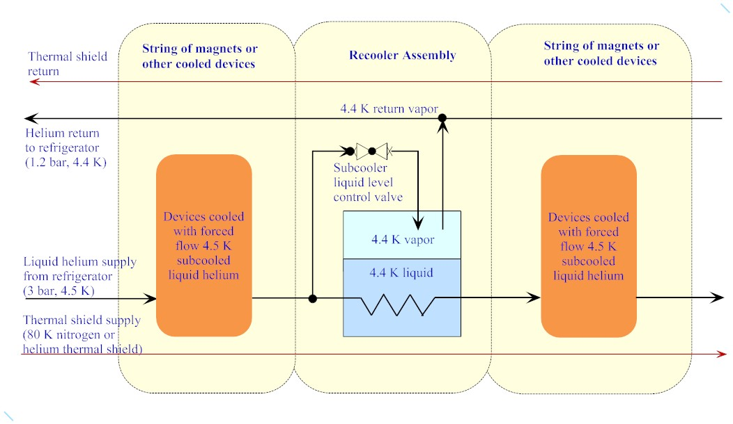
Recooler flow scheme

Slide 17
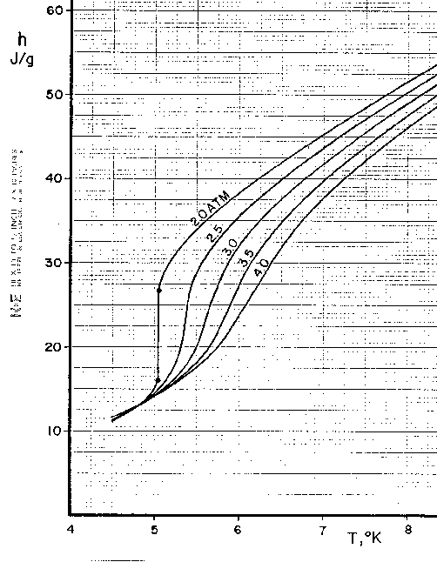
Heat transport through channels--pressurized normal helium
This plot of helium enthalpy versus T illustrates the large amount of heat absorbed (20+ J/g) if one can tolerate 6.5 K or even more
Nominally “5 K” thermal intercept flow may take advantage of this heat capacity
H(J/g)
40
30
20
10
5
6
7
T (K)

Slide 18
From http://webbook.nist.gov/chemistry/fluid/

Slide 19
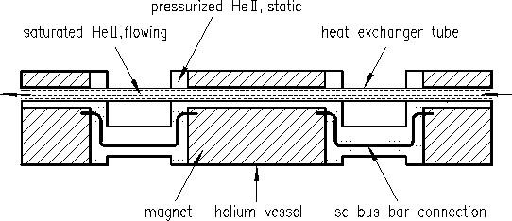
LHC magnet cooling scheme similar to Tevatron in also being indirect cooling, i.e., helium-to-helium heat transfer in the magnets

Slide 21
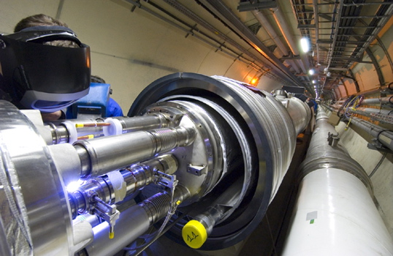
LHC magnet in tunnel

Slide 22
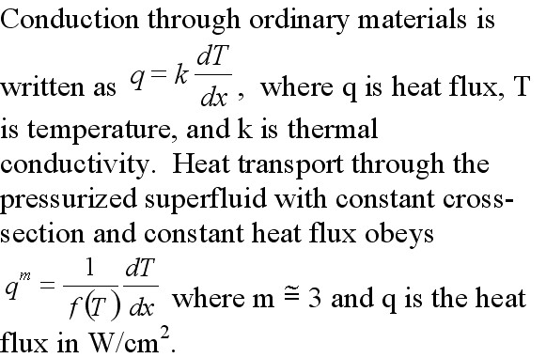
Heat transport through channels--pressurized superfluid

Slide 23
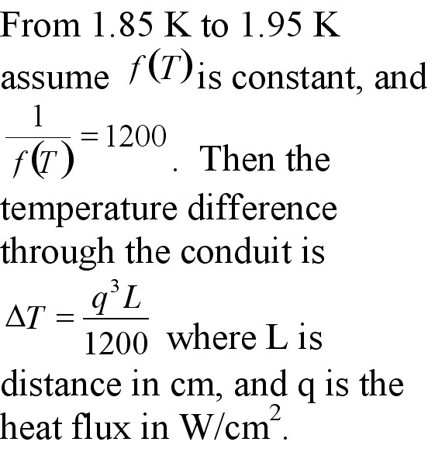
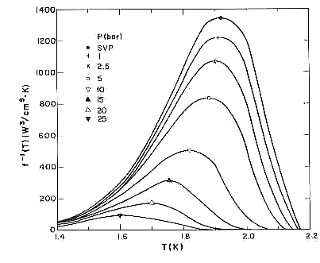
Superfluid Heat Transport Function
(Steven W. VanSciver, Helium Cryogenics, p. 144)
1/f(T)
1.6
T(K)
2.0

Slide 24
Helium II heat transport reference
“Practical data on steady state heat transport in superfluid helium at atmospheric pressure”
  By G. Bon Mardion, G. Claudet, and P. Seyfert, in Cryogenics, January 1979
Solve the last equation on slide 22 for q, with a constant diameter channel and length L, and integrate over the temperature range from Tc to T-lambda
One then has q•L^{1/m} = W(Tc,Tw), where the function W = (∫(dT/F(T)))^{1/m}
  Bon Mardion, et. al., use m = 3.4

Slide 25
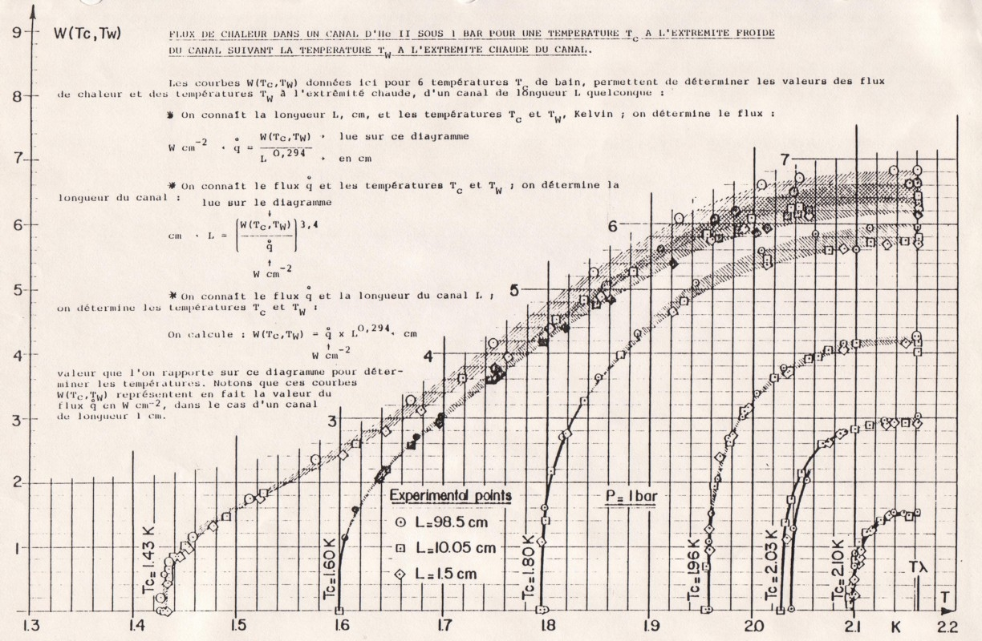

Slide 26
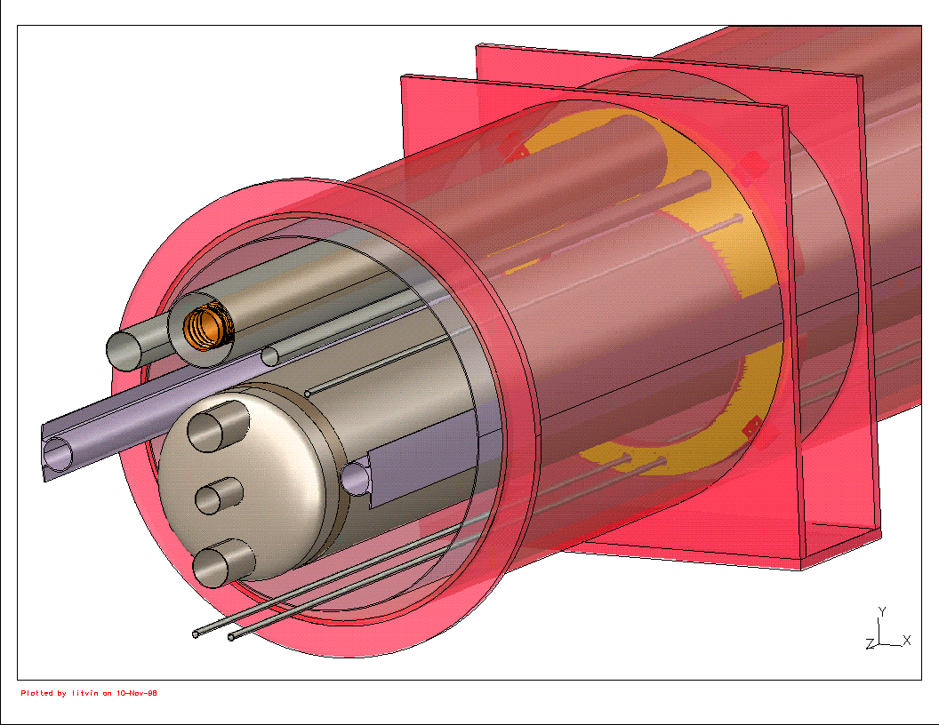
LHC final focus quad sketch
Support
Heat Exchanger
Helium pipes
Thermal
Shield
Cold Mass
Beam tube
Vacuum Vessel

Slide 27
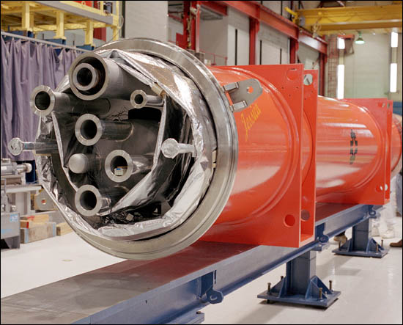
A super-
conducting
magnet built
by Fermilab
for LHC at
CERN in
Geneva,
Switzerland
Consists of layers from cold inside to warm outside -- magnet, inner pipes, thermal insulation, steel vacuum container

Slide 28
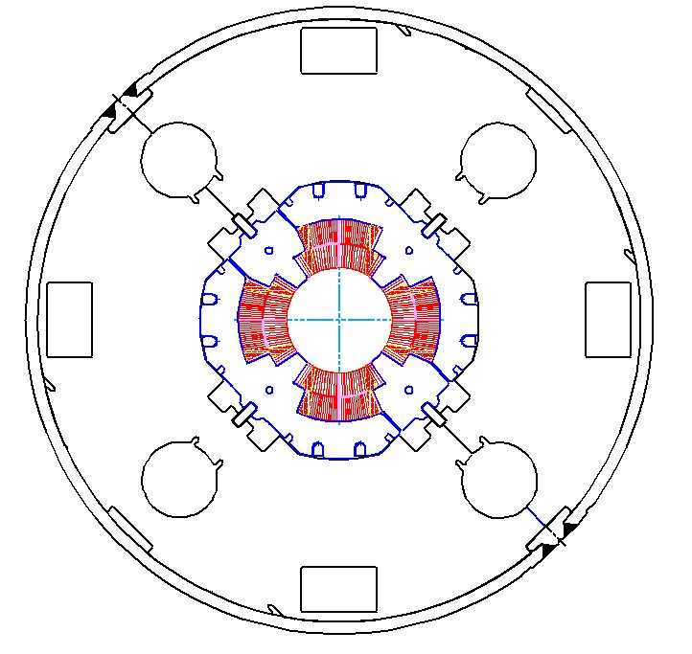
LHC IR quadrupole cold mass
Liquid helium cooling channels
Cross section of “cold mass” of an LHC IR quadrupole SC magnet
Helium also in
annular space
between coil
and beam pipe
Particle
beam
Superconducting
Cable
Iron

Slide 29
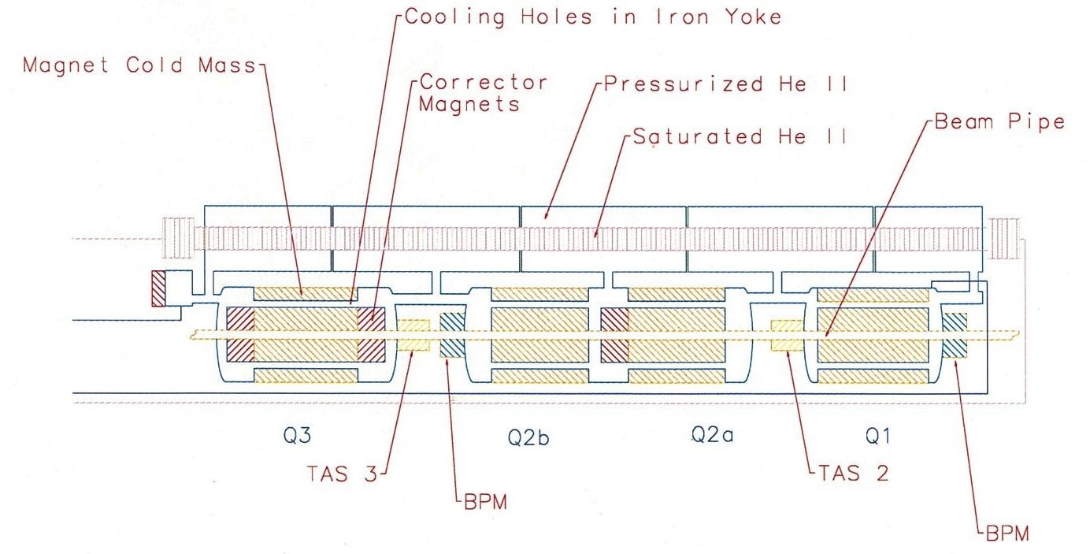
LHC IR quad cooling scheme

Slide 30
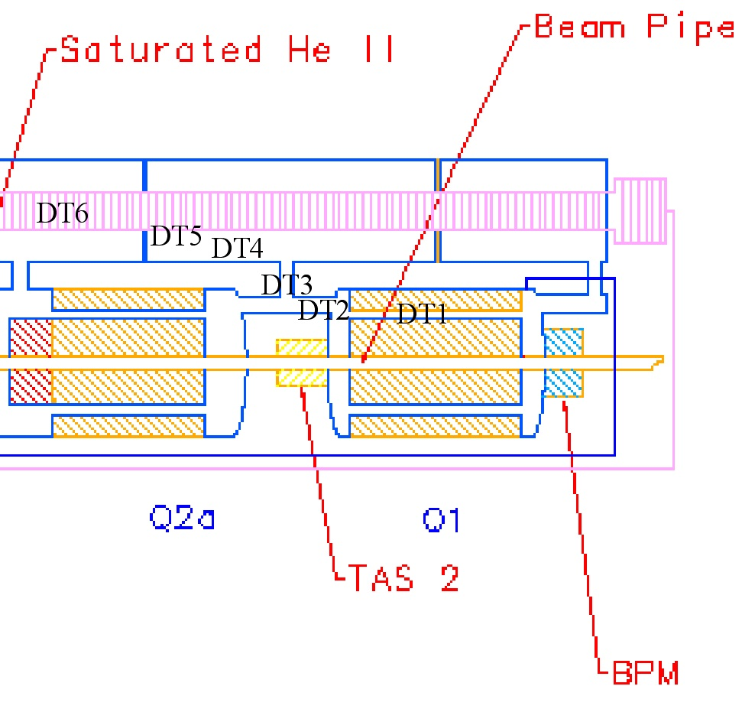
LHC IR quad heat flow path
Analyses of two heat load levels on next two slides

Slide 31
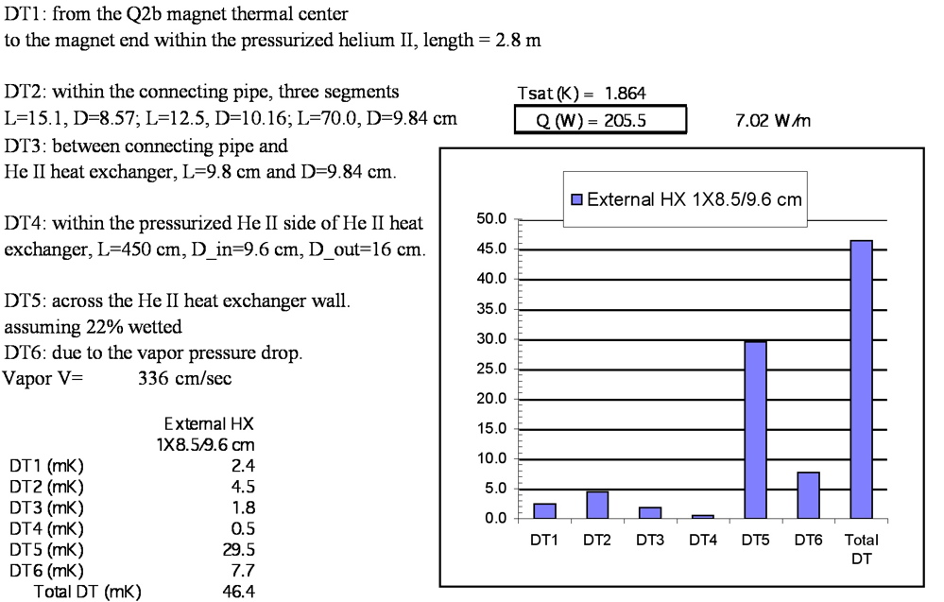

Slide 32
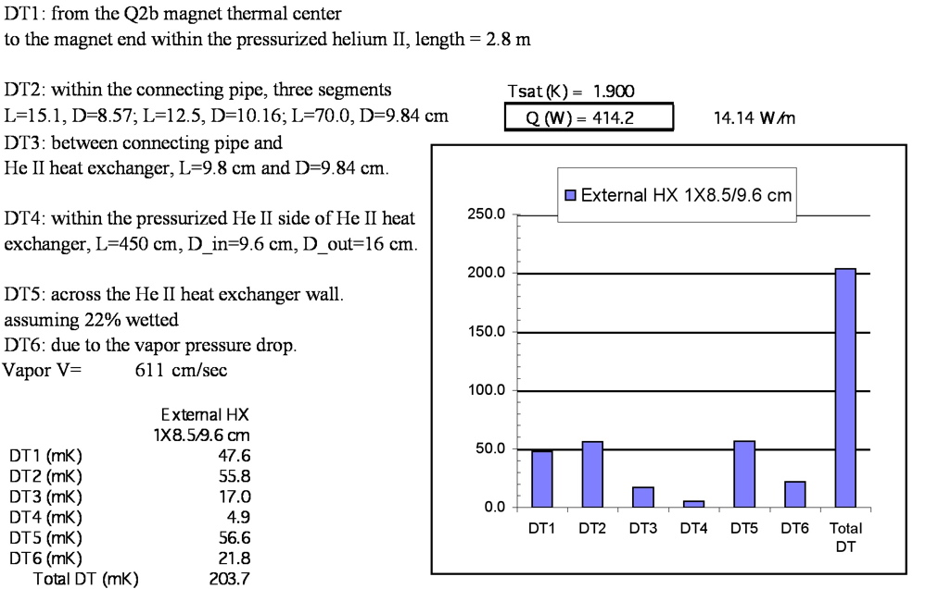

Slide 33
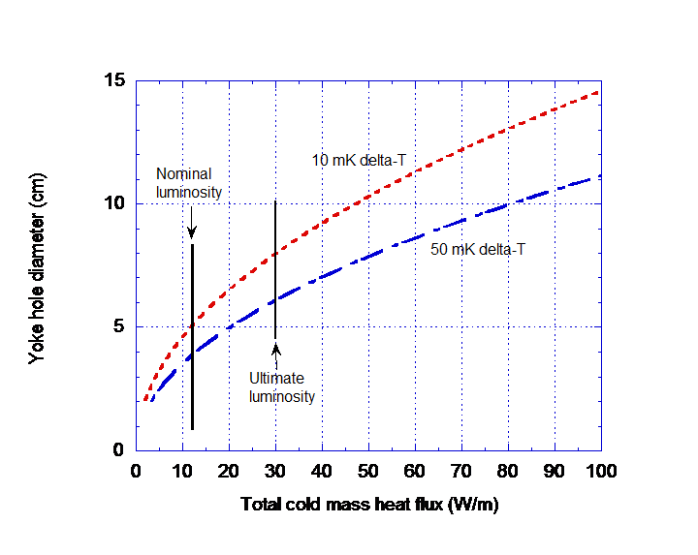
Dependence of temperature rise to the coil on yoke hole diameter for heat transport

Slide 34
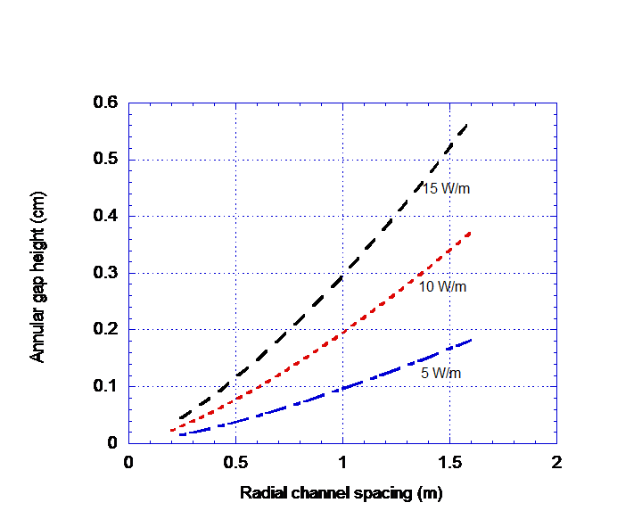
Trade-off of annular gap height between beam tube and coil, and frequency of radial channels for heat transport out to the yoke holes

Slide 35
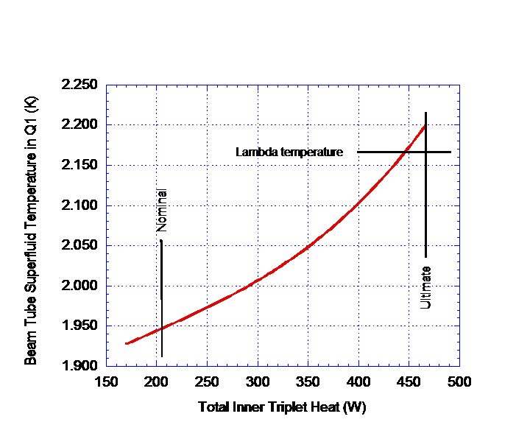
Predicted beam tube helium temperature versus total heat load

Slide 36
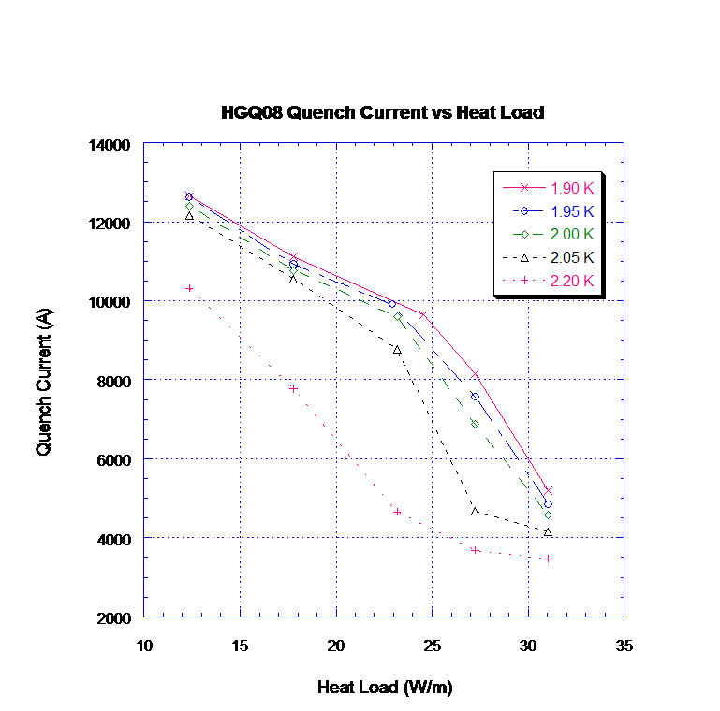
Quench current study in our vertical test cryostat – heat generated from
current ramp rate to
simulate beam heating. Note decline of quench current in normal helium.

Slide 37
Conclusion
Analyses helped to define channel parameters for cooling the LHC final focus quadrupoles
The thermal design was also checked with various tests including operation of a dedicated heat transfer model (heaters and pipes) cooled with helium II in a configuration similar to the magnets
It all works. These magnets focus the LHC beam into the detectors in LHC, meet specifications, and were a critical part of the accelerator in finding the Higgs

Slide 38
Detector magnets
Different size, shape, and conductor requirements result in different cooling schemes for detector magnets
  Different from accelerator beamline magnets
  Various options and design examples for various detectors
Here I describe a mu2e large magnet cooling concept as an example of thermal siphon cooling
  Thanks Nandhini Dhanaraj for the slides!

Slide 39
Background
The Transport Solenoid transport the muons produced in the production solenoid to the detector solenoid whilst filtering unwanted particles along its path.
The Transport Solenoid has an upstream section and a down stream section which house the magnetic coils within aluminum housings.
The heat load generated by these coils during operation and the heat loads on the supports will have to be cooled to maintain superconductivity of the solenoid.

Slide 40
Cryogenic Specifications
The Transport Solenoid will be indirectly/conductively cooled by running 4.5 K helium along the cooling circuit.
The magnet heat load at 4.5 K is estimated to be around 40 W each for the upstream and downstream sections and about 80% of this is expected at the supports via conduction.
A conservative estimate of 15 W has been considered for the heat load generated by the coils.
This is a low enough heat load to incorporate a Thermosiphon cooling scheme for the solenoid.

Slide 41
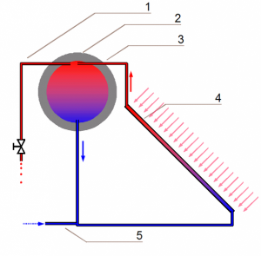
Thermosiphon Cooling Scheme
Thermosiphon is a cooling scheme which utilizes the density difference between the liquid and the vapor/warm liquid phase of a coolant as the driving force.
Thermosiphon is very efficient for low load systems as it eliminates the need for a circulating pump.
  Provides nearly isothermal cooling with no added load from pump work
Designing a thermosiphon cooling system involves characterizing the pipe geometry, verification of heat flux and flow regimes and required liquid head.
Helium Gas Return
Reservoir
2 Phase Helium Return
Magnet Heat Load
Helium Supply

Slide 42
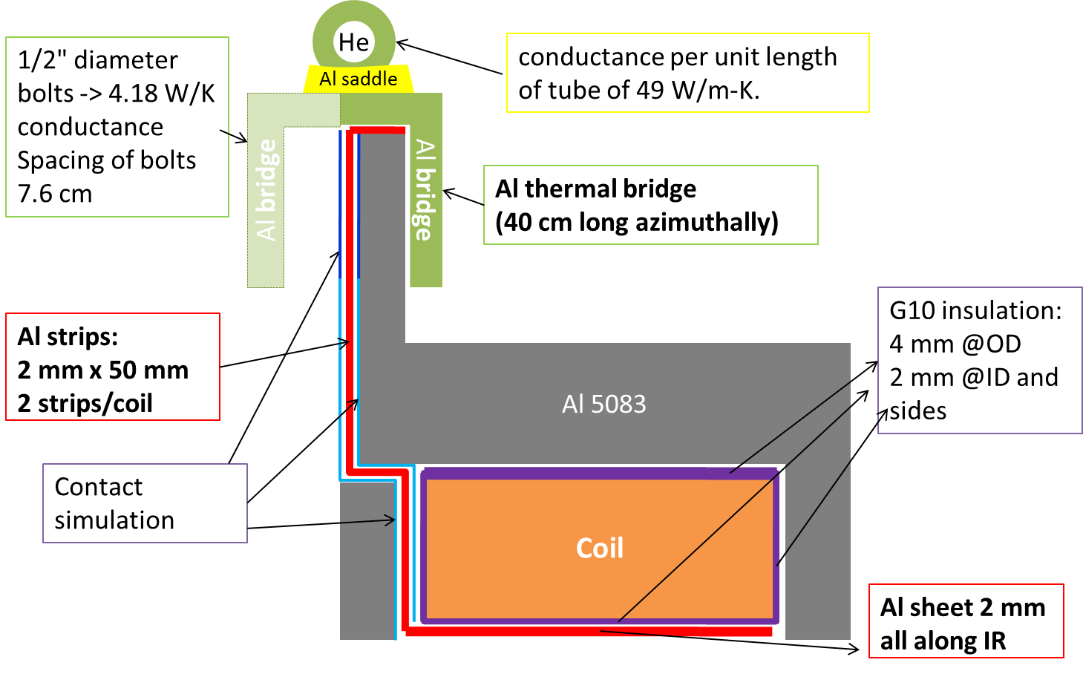
Thermosiphon Cooling Tube Selection
Design Parameters
Estimated Heat Load for TSu | 15 | Watts
Siphon pipe ID | 2.54 | cm
Siphon pipe length | 373.6 | cm
Siphon pipe surface | 2979.7 | cm^2
Number of siphon pipes | 8
Fraction of surface heat transfer | 0.3
Surface heat flux | 0.0021 | W/cm^2

Slide 43
Flow Regimes
Natural Convection
Nucleate Boiling
Film Boiling

Slide 44
TSu Cooling Layout
Helium Supply
Siphon Tubes
HGR Pipe
Helium fill pipe
Solid Model of TSu- D. Evbota

Slide 45
Design Comparison
 | ATLAS | CMS | MICE | TSu-FNAL
Cooling Scheme | Forced, Thermosiphon (backup) | Thermosiphon | Thermosiphon | Thermosiphon
Heat Load (W) | 50 | 400 | 4.5 | 15
Tube ID (cm) | 1.8 | 1.4 | 2.2 | 2.54
Number of tubes | 2 | 96 | 8 | 8
Length (cm) | 3600 | ? | ? | 373.6
Heat Transfer Fraction (assumed) | 0.3 | ? | ? | 0.3
Heat Flux (W/cm^2) | 0.008 | 0.0012 | 0.00025 | 0.002

Slide 46
Thermal siphon comments
Low heat flux and low vapor fraction required
  Correlations for avoiding plug flow which would lift liquid out of the tubes
  Parallel flow paths with no independent control of flow
Cool-down and warm-up provisions may require some special valve arrangements to permit forced flow
See the paper by B. Baudouy (references) for a nice report on some thermal siphon test data.

Slide 47
References-1
Thomas J. Peterson, “The Nature of the Helium Flow in Fermilab’s Tevatron Dipole Magnets,” Cryogenics, Vol. 37, No. 11, 1997.
S.W. Van Sciver, Helium Cryogenics, Plenum Press, New York, 1986.
G. Bon Mardion, et al, “Practical Data on Steady State Heat Transport in Superfluid Helium at Atmospheric Pressure,” Cryogenics, January, 1979.
L. Chiesa, et al, “Thermal Studies of a High Gradient Quadrupole Magnet Cooled with Pressurized, Stagnant Superfluid,” IEEE Transactions on Applied Superconductivity, March, 2001.

Slide 48
References-2
Ch. Darve, et al, “He II Heat Exchanger Test Unit for the LHC Inner Triplet,” Advances in Cryogenic Engineering, Vol 47A, 2002, Pg. 147.
R. Byrns, et al, “The Cryogenics of the LHC Interaction Region Final Focus Superconducting Magnets,” 17th International Cryogenic Engineering Conference, Bournemouth, UK, 14 - 17 Jul 1998, pp.743-746.
B. Baudouy, “Heat and Mass Transfer in Two-Phase He I Thermosiphon Flow,” Advances in Cryogenic Engineering, Vol 47B, 2002, Pg. 1514.

